Slide 1

Bank Loan Of Customers
P615

Slide 2
Team Members(Group 1)
1. Sanofar Fathima
2. Abhishek. G
3. Vinay M.B
4. Manaswi
5. MD Suhan Sk
6. Sneha

Slide 3
Project Overview
Analyzing bank loan data to understand trends and provide recommendations for better loan management.
Identify Loan Trends: Track loan amounts and customer profiles.
Manage Risk: Evaluate impact of verification status and loan grades.
Optimize Marketing: Focus on state-wise loan demand.
Enhance Services: Improve loan products based on customer insights.

Slide 4
KPI’S
Year wise loan amount Stats
Grade and sub grade wise revol_bal
Total Payment for Verified Status Vs Total Payment for Non Verified Status
State wise and month wise loan status
Home ownership Vs last payment date stats

Slide 5
Year wise loan amount stats : This KPI is to find out the relation between loan amount taken by customers and issue date . It compares the loan amount taken by customers from year to year . To show the rise or drop in loan amount taken.
Grade and sub grade wise revol_bal: This KPI is to find out the relation between Grade, sub-grade and revol_bal.
It show the total revol_bal contributed from each sub-grade and grade.
Total Payment for Verified Status Vs Total Payment for Non Verified Status:
The Key Performance Indicator (KPI) aims to find the relationship between loan amounts taken by customers based on their verification status.
State wise and month wise loan status
State-wise loan status :
The chart shows the count of different loan statuses (e.g., Current, Fully Paid, and Charged Off) across various states.
Year-wise loan status based on last_credit_pull_d :
This chart shows the number of loans in various statuses over time.
Home ownership Vs last payment date stats:
is to find out the relation between home ownership of customers and last payment date. To compare the last payment of customers with their home ownership status.

Slide 6
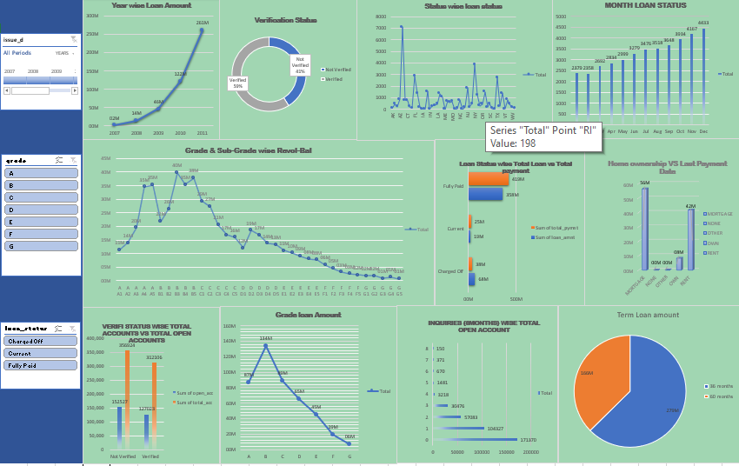
Microsoft Excel Dashboard

Slide 7
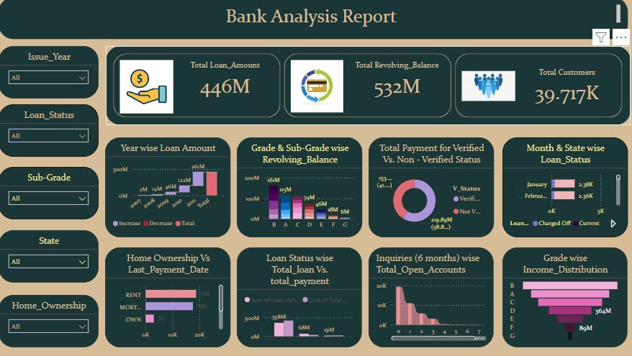
Power Bi Dashboard

Slide 8
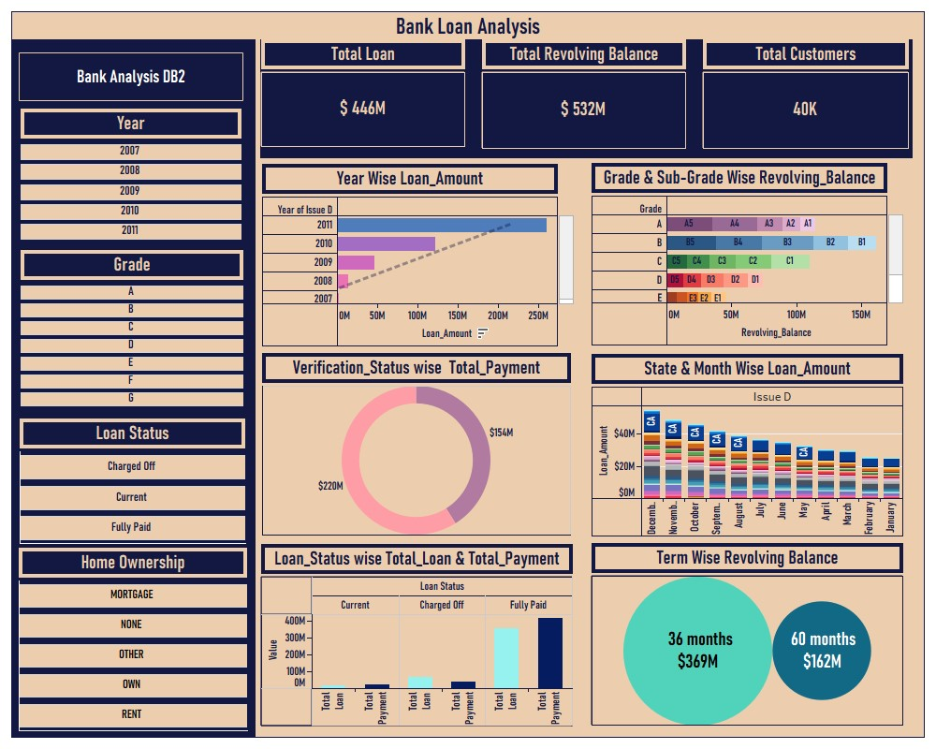
Tableau Dashboard

Slide 9
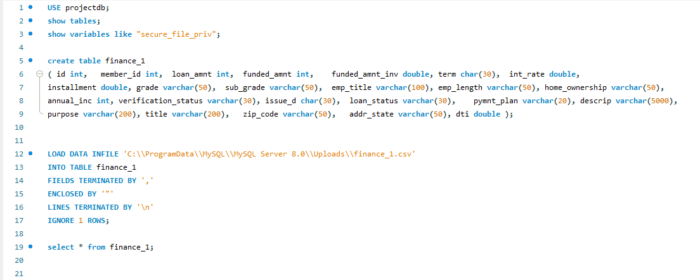
MySql Queries

Slide 10
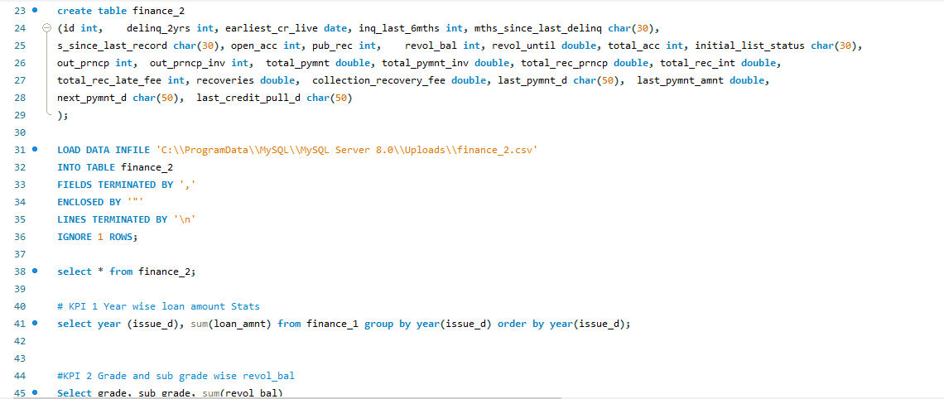
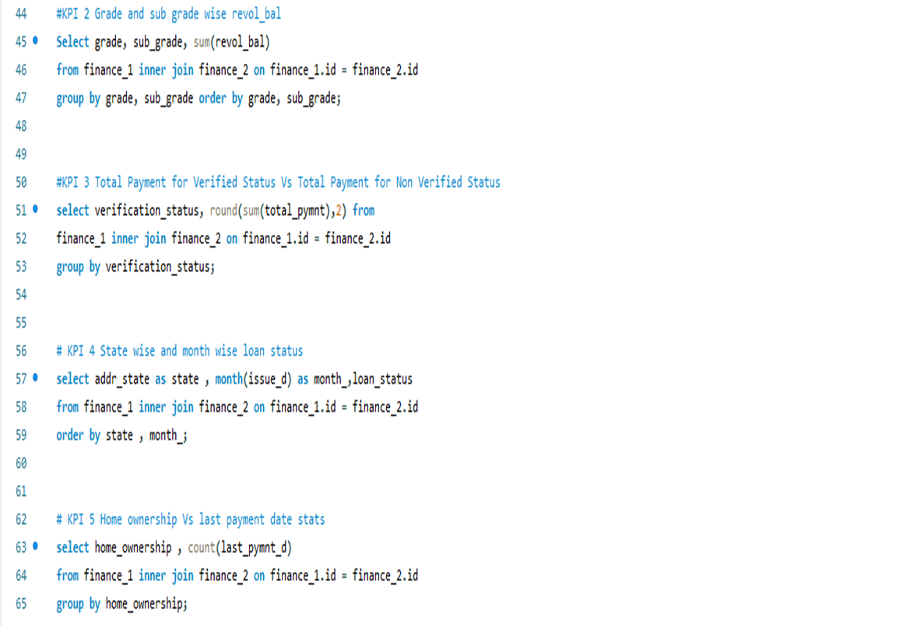

Slide 11
CONCLUSION:
The bank loan analysis project has provided valuable insights into customer behavior, loan distribution and risk management. By understanding these trends and implementing the recommended strategies, the bank can enhance its loan portfolio management, reduce risks, and improve customer satisfaction. The data-driven approach will enable th The bank loan analysis project has provided valuable insights into customer behavior, loan distribution and risk management. By understanding these trends and implementing the recommended strategies, the bank can enhance its loan portfolio management, reduce risks, and improve customer satisfaction. The data-driven approach will enable the bank to make informed decisions, optimize marketing efforts, and tailor loan products to meet customer needs effectively.
The analysis of bank loan data from 2007 to 2011 reveals significant growth in loan disbursements, indicating robust demand for loans and effective customer acquisition strategies. The predictive model developed in this project provides a valuable tool for assessing loan repayment likelihood, helping banks mitigate risks and improve their lending processes. e bank to make informed decisions, optimize marketing efforts, and tailor loan products to meet customer needs effectively.
The analysis of bank loan data from 2007 to 2011 reveals significant growth in loan disbursements, indicating robust demand for loans and effective customer acquisition strategies. The predictive model developed in this project provides a valuable tool for assessing loan repayment likelihood, helping banks mitigate risks and improve their
lending processes.

Slide 12
Thank You

